Slide 1
Kraken: Metagenomic sequence classification
Rushali Chopra
PBL WiSe 23/24

Slide 2
Outline :
Introduction
Approaches before Kraken
Kraken
K-mer approach
Minimizer
Lowest common Ancestor (LCA)

Slide 3
Datasets
Other variants of Kraken
Clade Exclusion Experiments
Take home message

Slide 4
What is Metagenomics ?
Genomic analysis
Culture-independent information
[1]
Notes:
Genomic analysis of microbial communities by extracting and sequencing their DNA .
Metagenome - consisting genomes of many individual microorganisms.
Culture -independent info abot environental microorganisms
Metagenomics classifiers attempt to assign a taxonomic identity to each read in a dataset. Because metagenomics data often contain tens of millions of reads, classification is typically done using exact matching of short words of length k (k-mers) rather than alignment, which would be unacceptably slow.

Slide 5
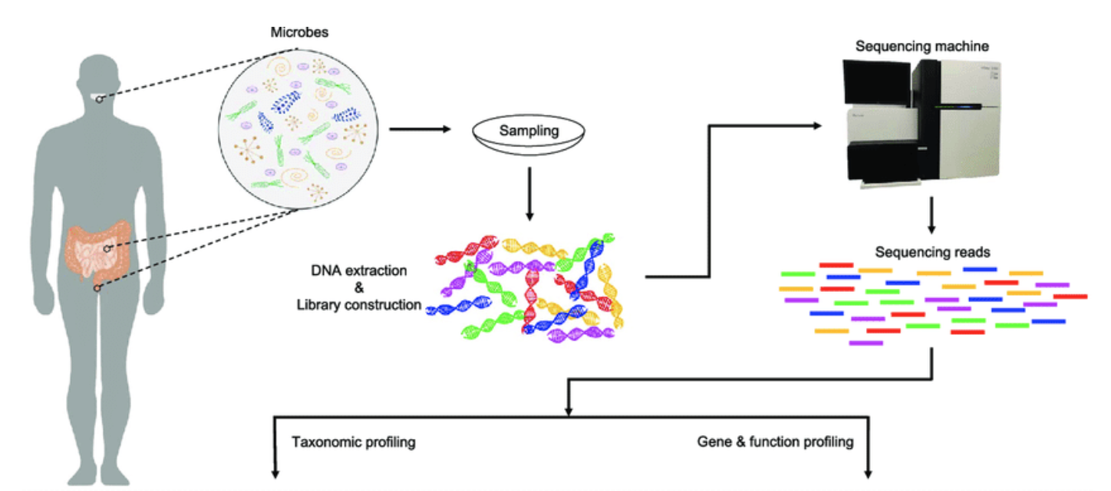
Metagenome Classification
[1]
Notes:
Workflow for metagenomics -
Microbes obtained from human gut , DNA extracted , sequenced and then used in metagenomics projects

Slide 6
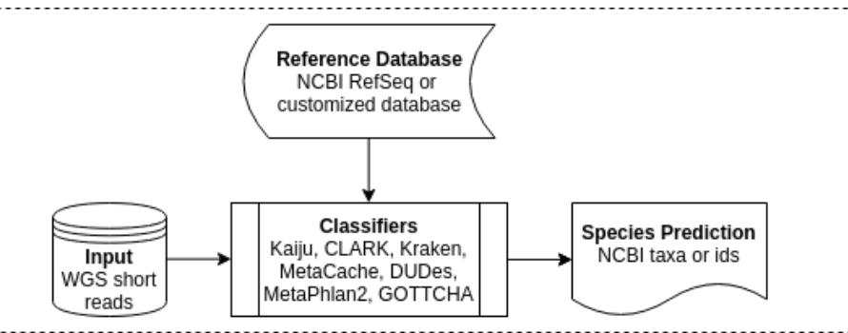

Slide 7
Challenges in Metagenomics
Sample complexity
Database limitations
Misclassification
Sequencing errors
Noise
Notes:
Sample complexity: thousands of diff. Species leading to FP and FN
Database limitations:limited databases leads to misclassification or failure to identify
Sequencing errors: introduces noise further leading to incorrect classification.

Slide 8
Algorithms before Kraken :-
BLAST
Sequence Similarity
MEGAN
Sequence Alignment (BLAST) and LCA
Naive Bayes Classifier
K-mer distribution using Bayesian Rule
Notes:
Metagenomics projects can generate a huge amount of sequence data.
BLAST - assigns score based on local similarity

Slide 9
Algorithms before Kraken :-
Phymm and PhymmBL
phylogenetic classification
scores from interpolated Markov Models
MetaPhlAn
Abundance estimation
Notes:
These methods can be broadly divided into three categories: (1) sequence-similarity-based methods,(megan and megablast) (2) marker-based methods(MetaPhlAn ) where certain specific marker sequences are used to identify the species. (3) sequence-composition-based methods(Kraken , LMAT), which are based on the nucleotide composition (e.g. k-mers usage)

Slide 10
Abundance estimation:-
faster approach
Small subset classification
Marker genes
Not detailed enough
Notes:
Classify only a small percentage of genes though,characterize the distribution of organisms present in a given sample, rather than labelling every single read.
to limit the processing burden,they cannot help with analyses that require more details about the sample.

Slide 11
KRAKEN
100 bp reads with rate 4.1 million rpm
909x faster than Megablast
11x faster than MetaPhlAn.
Highly accurate taxonomic labels
Exact k-mer alignment
Ultra fast

Slide 12
How kraken works?
Collection of Reference Genomes
K-mers generation and counting
Jellyfish
Notes:
Jellyfish(k-mer counting algorithm that uses suffix arrays as data structure) multithreaded k-mer counter is used to create a database containing every distinct 31-mer in the library.
Both for reference and input samples

Slide 13
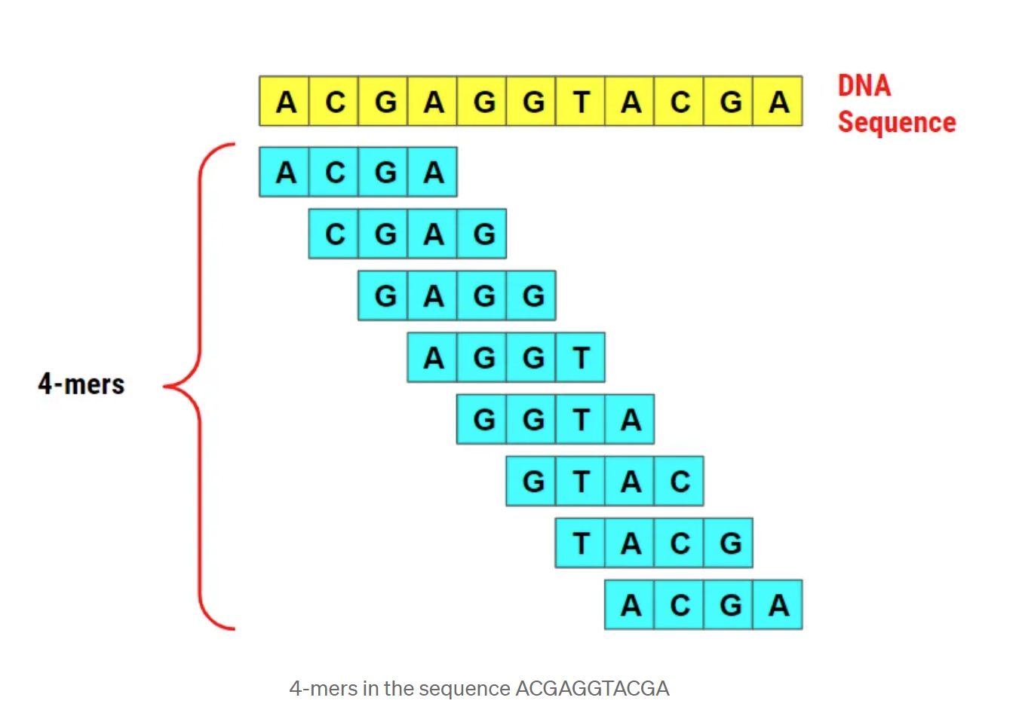
RECAP :- K-mer approach
[2]
Notes:
Relevance of adjacent k-mer in minimizer to get rid of redundant seqs

Slide 14
K-mers’ LCA labels:-
4 byte space
Before: k-mer counts
After: Taxonomic ID numbers
Notes:
Once the database is complete, the 4-byte spaces Jellyfish used to store the k-mer counts in the database file are instead used by Kraken to store the taxonomic ID numbers of the k-mers’ LCA values
The taxonomic labels obtained from the database lookup are subjected to algorithms, such as the Lowest Common Ancestor (LCA) algorithm, to determine the taxonomic ID assigned to the entire query sequence.
Taxonomic ids of kmers lca

Slide 15
RECAP :-Minimizer Concept
K-mers to minimizers (smaller length)
Lexicographical sorting
Smallest of S and reverse complement(S)
Notes:
Minimizer – reference
94 pairs - 188 words arranged alphabetically- AAAGCGC

Slide 16
Canonical representation
Sequence(S) - ATTATGCCAA
Reverse(S) - AACCGTATTA
Reverse Complement - GCAT
From ATGC and GCAT -> ATGC chosen
Notes:
Lexicographically smaller of S and its reverse complement

Slide 17
Why Minimizer ?
Reduced search space
Avoid Redundant searches
computationally efficient
Data from Cache instead of RAM
Notes:
Link from k-mer with redundant searches
accurate assignment of taxonomic labels
Kraken optimizes its performance by loading a significant portion of the reference database into RAM=fast access
CPU cache to store frequently accessed or recently used data. By utilizing the cache, Kraken minimizes memory access
enabling efficient handling of large datasets

Slide 18
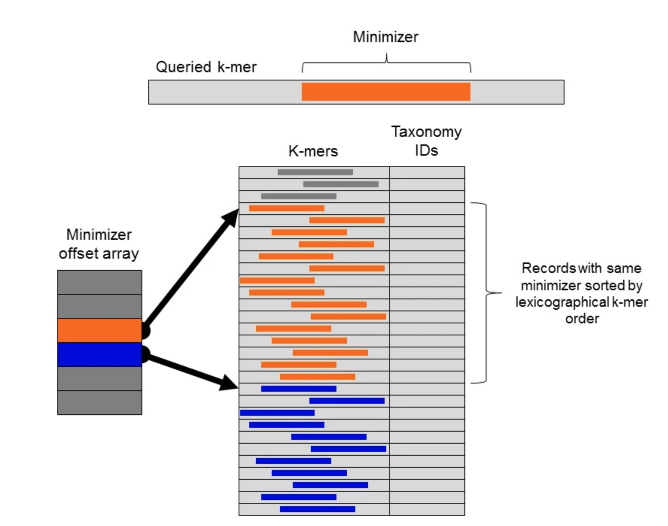
[3]
Notes:
The LCA taxonomic ID represents the highest taxonomic level shared by all taxonomic labels associated with the minimizers in the query sequence. This ID is assigned to the sequence as its taxonomic classification.Once the matching k-mers have been identified and their abundance and specificity assessed, Kraken employs the LCA algorithm to assign a taxonomic label to the sequence. The LCA is essentially the taxonomic level at which the identified k-mers share a common ancestor.
So now lets discuss how minimizers are actually used in classification.

Slide 19
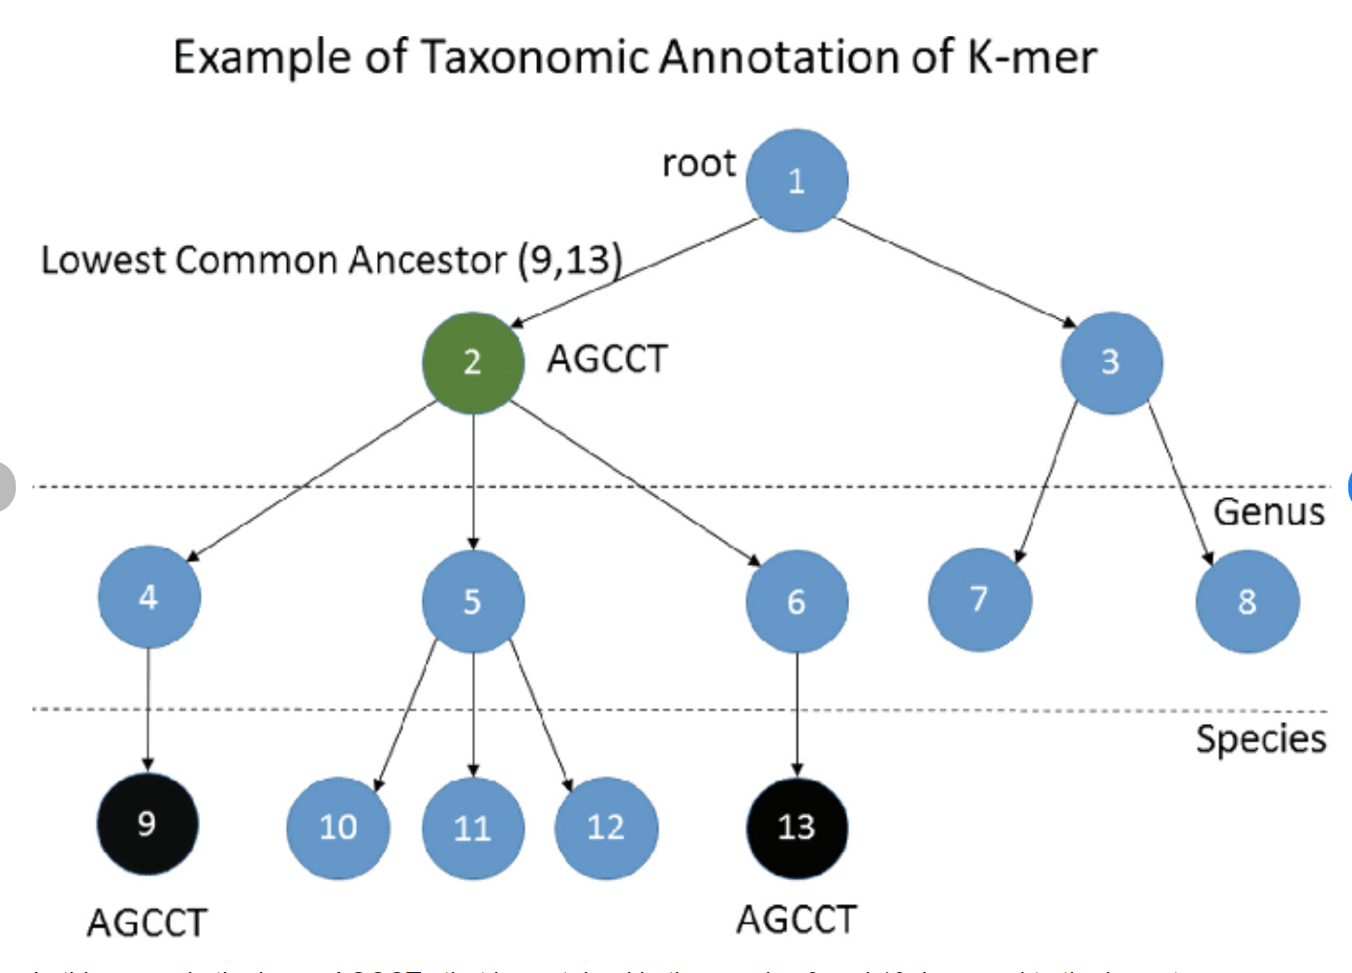
[3]

Slide 20
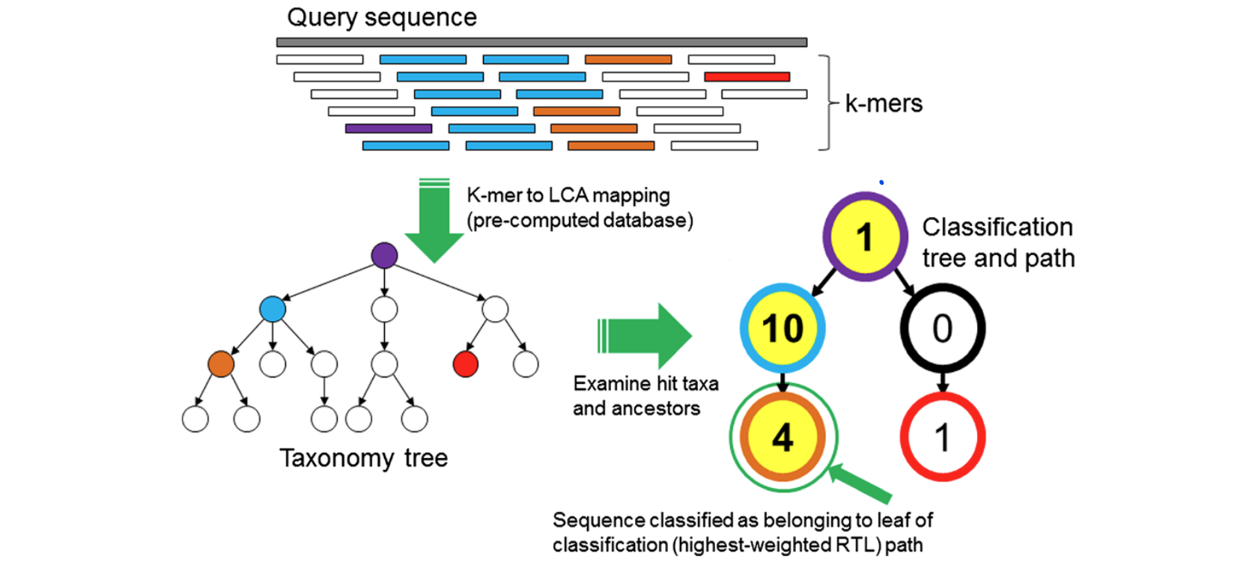
[4]
Notes:
In the previous slide how we mapped one kmer , here we create taxonomic tree using multiple kmers of quey seq.
Using this seq kmers’ taxon and their ancestors -> classification tree formed
To classify a sequence, each k-mer in the sequence is mapped to the lowest common ancestor (LCA) of the genomes that contain that k-mer in a database. The taxa associated with the sequence’s k-mers, as well as the taxa’s ancestors, form a pruned subtree of the general taxonomy tree, which is used for classification. In the classification tree, each node has a weight equal to the number of k-mers in the sequence associated with the node’s taxon. Each root-to-leaf (RTL) path in the classification tree is scored by adding all weights in the path, and the maximal RTL path in the classification tree is the classification path (nodes highlighted in yellow). The leaf of this classification path (the orange, leftmost leaf in the classification tree) is the classification used for the query sequence.
Kraken breaks down the input sequences into k-mers of the same length used during the database construction phase (e.g., 31-mers).
The k-mers from the input sequences are then queried against the pre-built database of reference k-mers. This process allows Kraken to quickly identify matches between the input sequences and the reference genomes.

Slide 21
How higher speed ?
Binary decision method
Minimizers
Cache optimization

Slide 22
Data used:-
HiSeq (mean length μ = 92 bp)
MiSeq (mean length μ = 156 bp)
Sim-BA (100 bp reads with error rate from 1,967 bacterial and archaeal taxa)
Notes:
Simulated metagenome data - artificially generated genetic sequences that mimic the complexity and characteristics of real metagenomic data.
error rate five times higher than would be expected, to evaluate Kraken’s performance on data that contain many errors or have strong differences from Kraken’s genomic library.

Slide 23
Evaluation Metrics
Genus level sensitivity
Rank-level precision
Results close to Megablast
Notes:
sensitivity refers to the proportion of sequences assigned to the correct genus. Precision, also known as positive predictive value, refers to the proportion of correct classifications, out of the total number of classifications attempted. Kraken’s sensitivity and precision are very close to that of Megablast.
10.000 sequences classified.
A is the number of reads with an assigned genus that were correctly classified at that rank, and B is the total number of reads with any assigned genus.

Slide 24
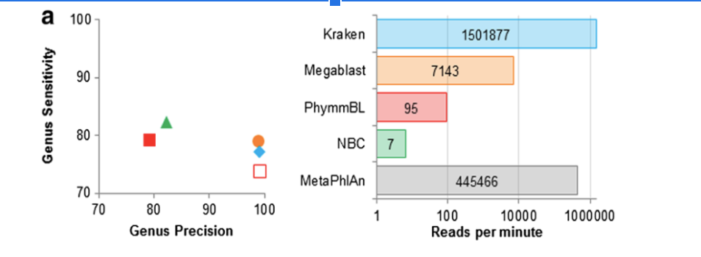
[5]
HiSeq Dataset
Notes:
MetaPhlAn only classifies a subset of reads that map to one of its marker genes, as it is an abundance estimation program) phmmbl65 - confidence filtered version
Kraken 150-240x fast than Megablast
PhmmBL <100 rpm
Nbc <10rpm
Fast
Sensitivity comparable to other classifiers as well

Slide 25
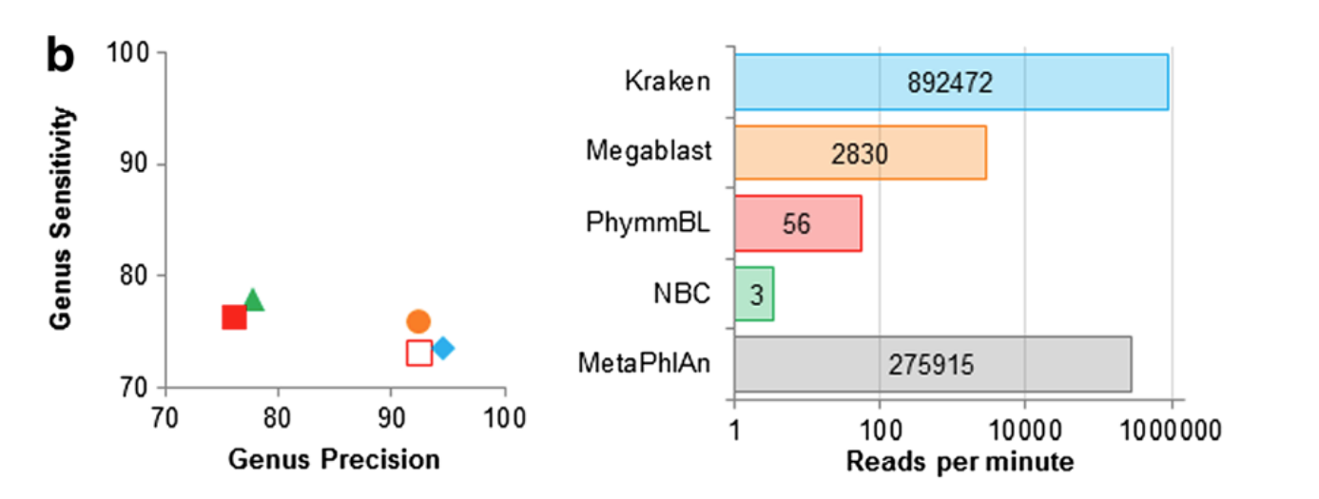
[6]
MiSeq Dataset
Notes:
Reads length increase ->low precision , sensitivity not comparable anymore , low - however kraken still the fastest, bcause of increase in read counts > increase in kmers, hence more processing required . Compare dto metaphlan , decrease in speed in kraken was significant

Slide 26
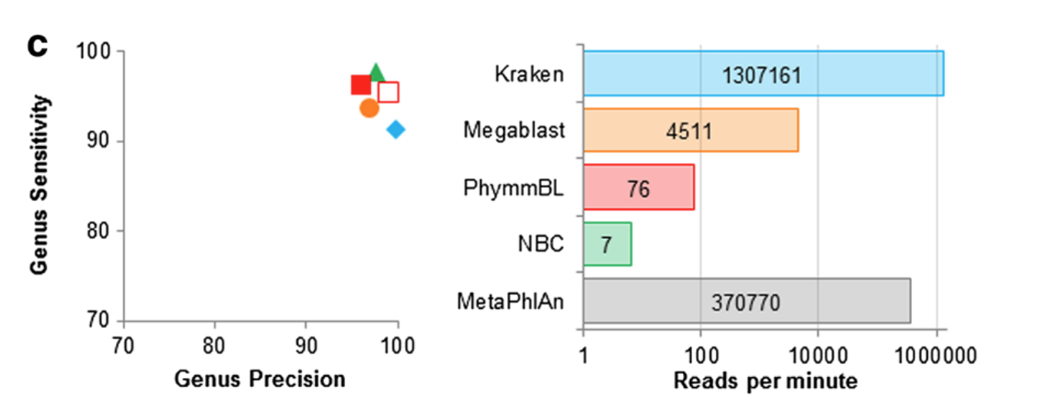
[7]
[8]
Sim-BA Dataset
Notes:
Worst performer compared to other classifiers , sensitivity increased , speed increased because of similar read length in hiseq

Slide 27
Other variants of kraken:
Smaller database (4 gb)- MiniKraken
Reduces memory requirements
Sensitivity drops by 11%

Slide 28
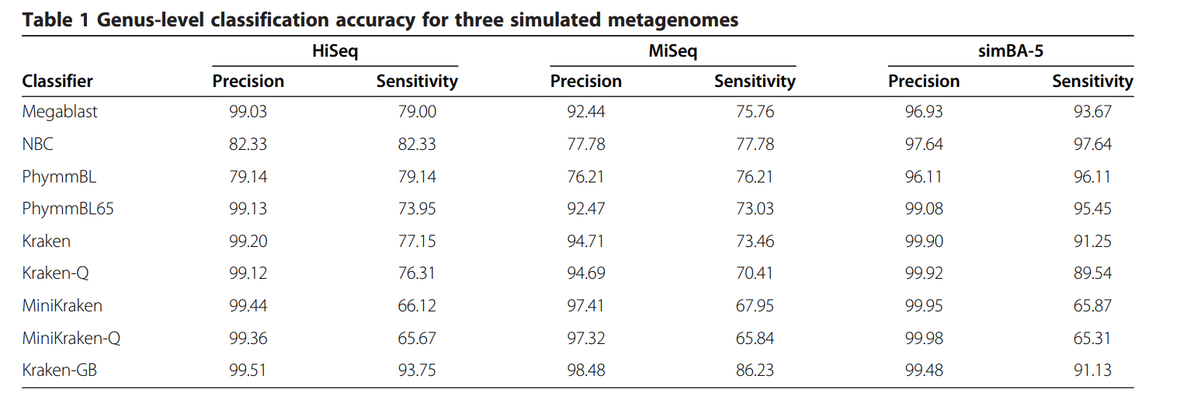
[8]
Notes:
On the high-error simBA-5 metagenome, MiniKraken’s sensitivity was more than 25 percentage points lower than Kraken’s, indicating that for short reads, high error rates can cause substantial loss in sensitivity. However, for all three metagenomes, MiniKraken was more precise than Kraken.

Slide 29
Other variants of kraken:
Database with GenBank’s draft and Bacterial + archaeal genomes - Kraken-GB.
Larger database than Kraken
Notes:
Our hypothesis was that Kraken-GB would have a higher sensitivity than standard Kraken for our metagenomes, by virtue of its larger database. Kraken-GB has a much higher sensitivity for the HiSeq and MiSeq metagenomes compared to Kraken (Figure 3 and Table 1), primarily due to the presence of two genomes in these simulated metagenomic samples that have close relatives only in Kraken-GB’s database

Slide 30
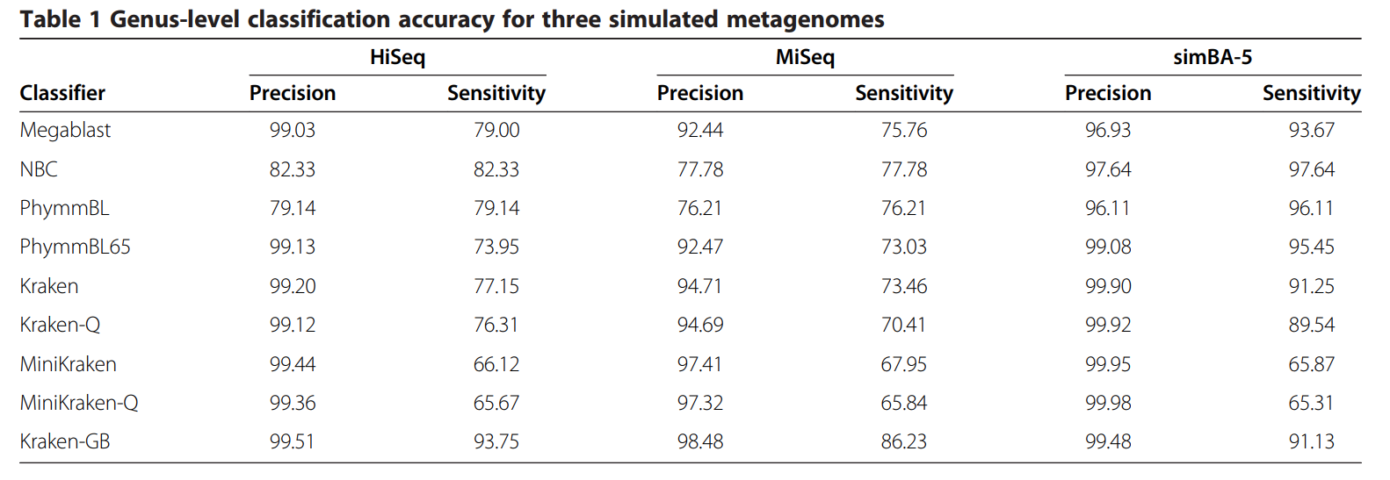
[9]

Slide 31
Other variants of kraken:
Kraken -Q
MiniKraken-Q
Notes:
MiniKraken’s high precision demonstrates that in many cases we do not need to examine all k-mers in a sequence to get the correct classification.
Instead of querying all k-mers in a sequence against our database, we instead stop at the first k-mer that exists in the database, and use the LCA associated with that k-mer to classify the sequence. (denoted by appending -Q) –MiniKraken-Q is slower than Kraken-Q, even when MiniKraken is faster than Kraken.
the classifier allows Kraken to skip tens or hundreds of k-mer queries per sequence, significantly increasing its classification speed with only a small fall in accuracy

Slide 32
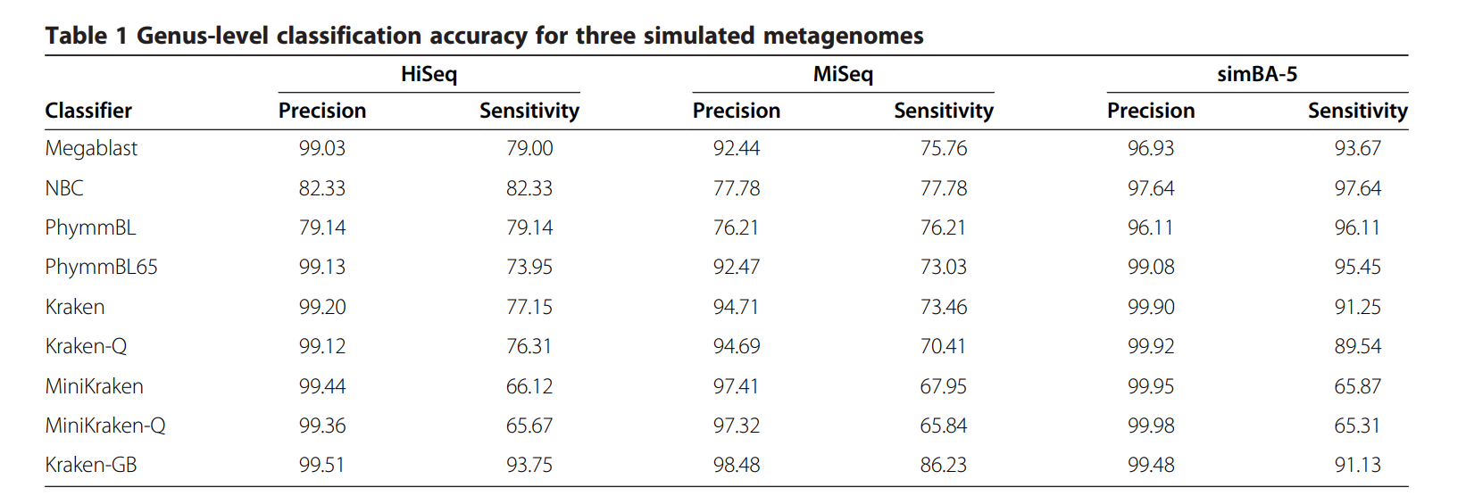
[10]
Notes:
to skip tens or hundreds of k-mer queries per sequence, significantly increasing its classification speed with only a small fall in accuracy
Because a database containing fewer k-mers requires more queries from a sequence to find a hit, MiniKraken-Q is slower than Kraken-Q, even when MiniKraken is faster than Kraken

Slide 33
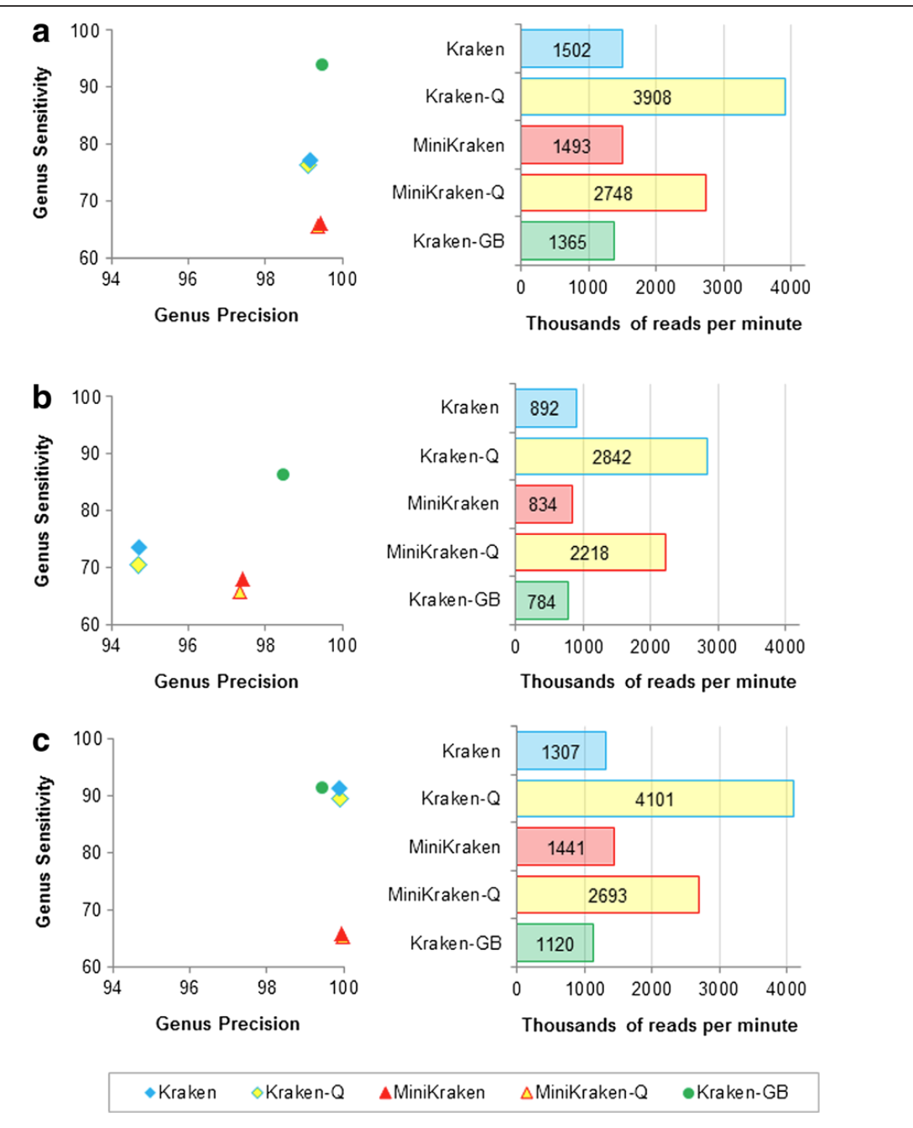
HiSeq
MiSeq
Sim-BA
[11]
Notes:
Kraken gb performed very bad
kraken-Q better as kraken

Slide 34
Clade exclusion experiments
Novel organisms
High rank level precision
Low sensitivity
Notes:
The lower sensitivity is attributed to Kraken's reliance on exact matches of relatively long k-mers.
Sequences from different genera rarely share long exact matches, which makes it challenging for Kraken to confidently classify reads with novel species.

Slide 35
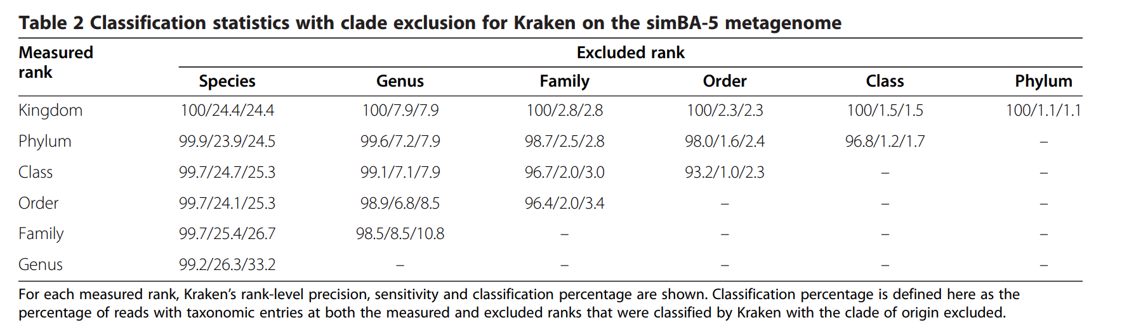
[12]

Slide 36
Advantages of kraken
Fast
High Precision
via short exact alignments(k-mers)
Classification at various taxonomic levels
Notes:
High Accuracy via short exact alignments

Slide 37
Advantages of kraken
Memory Efficient
Reference Database Flexibility
Other Applications
e.g de Bruijn Graphs
Reduced False positives

Slide 38
CONCLUSION
Workflow
Minimizer and LCA
Speed
Precision
Scalability
Notes:
1.ref database (NCBI) user modified-> k-mer generation and counting using jellyfish -> LCA algorithms used for kmers->kraken assigns taxonomic iD-> usre of minimisers for increasing speed i.e 2 step look up tree lexikographic-> mapping of k-mer of query sequence/ sample reads to LC-> generation of taxonomy tree-> scoring based maximum hits and RTL path-> best score classifies the genome
Speed because of minimizer, binary decision
Precision as it relies on exact k-mer match
Kraken's storage management contributes to its scalability, enabling efficient handling of large datasets

Slide 39
Sources
[1]-https://www.researchgate.net/figure/The-basic-outline-of-metagenomic-sequencing-and-data-processing-Mixed-microbial-cells_fig1_309080952
[2]-https://medium.com/swlh/bioinformatics-1-k-mer-counting-8c1283a07e29
[3]- [12] -https://genomebiology.biomedcentral.com/articles/10.1186/gb-2014-15-3-r46

Slide 40
THANKS FOR YOUR ATTENTION !

